Slide 1
Supply and Demand:
Oils and Oilseeds
Istanbul – September 20, 2018
Stephan Johansen

Slide 2
Structure
Sunflowerseed and oil fundamentals
  Crops
  Trade flows
  Exportable surplus
Relative values to other seeds and oils
Crush margins
Bio-Diesel
Sunflower meal
Soybeans
Canola / Rapeseed
Trade war

Slide 3
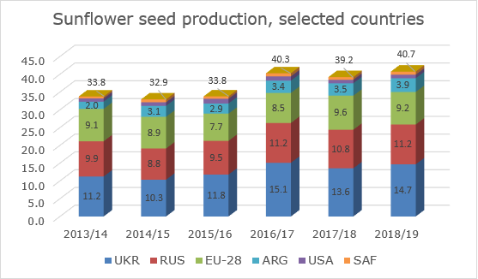
Global sunseed market
EU:
  Excess moisture
  Lower acreage
UKR + RUS
  Excellent growing conditions
  Massive acreage
  Bumper crop
Bearish sentiment
  Southern EU bids / buyers market for now
Low volatility (vs SBS & RS) until past 3 weeks decline
Notes:
Conditions were not ideal in Europe with excess of moisture and overall lower area than last year during planting
Conditions in Ukraine and Russia were good, thanks to timely rains and massive area
The market is expecting a bumper crop putting the oil market under pressure
The overall sentiment is bearish – definitively feels like a buyers market with S.EU origins bidding far below replacement FS
However, discounts to other oilseeds are large and consumption should adjust somewhat
While RS and SBS had an extremely volatile summer price wise - SFS didn’t rally and didn’t decrease drastically either before the past 3 weeks

Slide 4
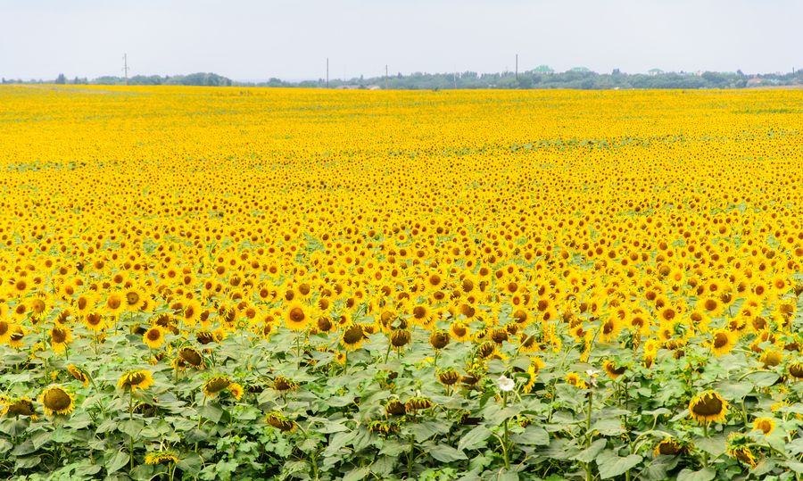
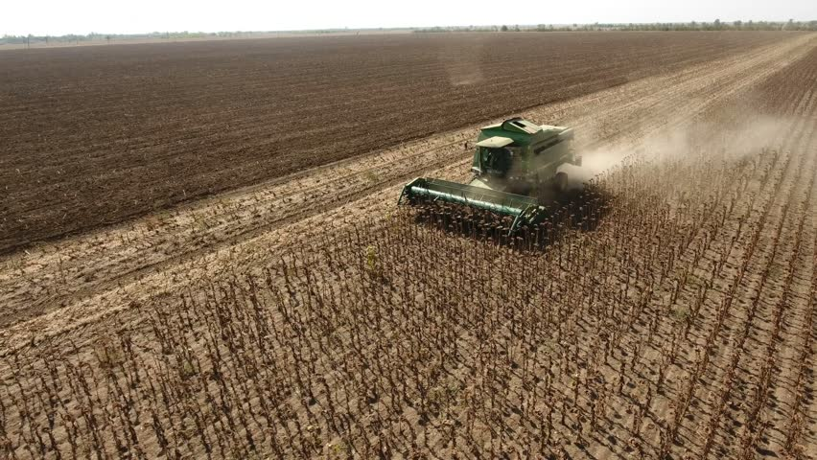
Ukrainian sunseed market
Rumors of 10% increase in acreage
  Switch from Barley
    Planting window missed
    Cold March + warm forecast 1-15 April
  Switch from SBS due to VAT
100% ROI at planting
Final increase in acreage 1%
  Crop rotation
Good growing conditions
Notes:
INITIAL talks of switch from barley to SFS in magnitude of +10%
Reason: barley and yellow peas sowing window missed as temperatures were below normal in Mch and fast temperature hike expected 1H Apr
This increased the risk of low barley yields and farmers could have skipped planting and chosen to plant sun OR corn later in April/May.
Additionally: fields planned for SBS could have been switched to SFS and corn due to export VAT coming into effect Sep 2018.
100% ROI for farmers planting SFS during planting window
Finally acreage increased by 1%
upside was limited by crop rotation and already high share of SFS
Winter lasted long and planting was delayed – finally conditions were great as needed rains came
Forecasts: yields 8%, crush 6%, exports multiplying X4, C/O unchanged
For the future crops: lately the ROI is either the highest, or close to it, so crop rotations are maxed out, would lead to large switches if ROI declines vs other crops

Slide 5
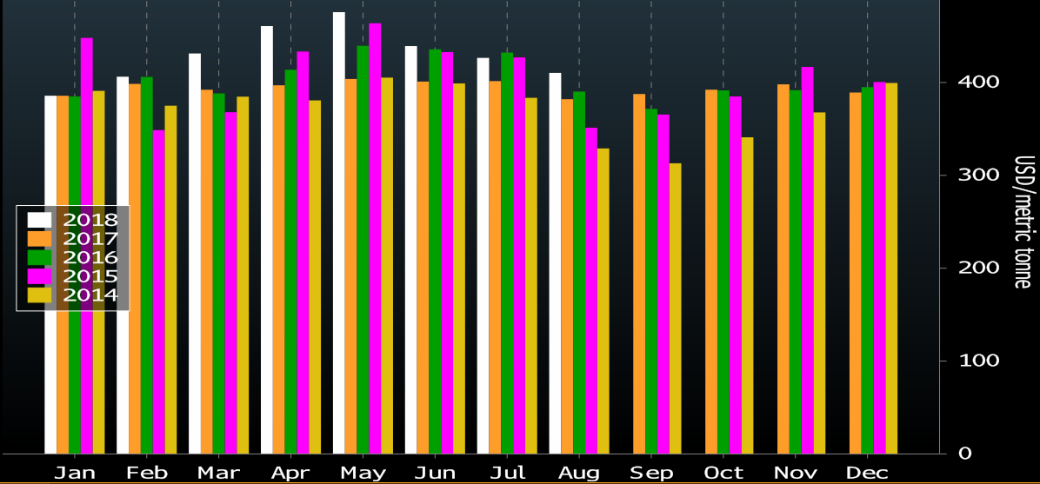
Ukrainian sunseed seasonal
Seasonality
  Crush capacity early in the season
  Follower by seed availability
  Seasonal lows around now
Rains slowing down harvest
22% harvested
  3.2mmt of 14.7mmt
Farmer selling at 5%
Notes:
Seasonality: driven by crush capacity early on and seed availability later in the season.
At the moment crush capacity and the harvest speed determines the price and we are in the period where the seasonal low is generally found
At the moment 30% crop is harvested (4.4 MMT out of 14.7 MMT crop).
Average yield pretty unchanged at 2.06 mt/ha.
Farmer selling is low at 600-700 KMT. It is expected to pick up, but yet slower pace than previous years as farmers are not happy with current prices
Daily farmer selling around the country at 20-25k.
Earlier rains shall slow down harvest pace a bit, but this supports winter rapeseed planting.

Slide 6
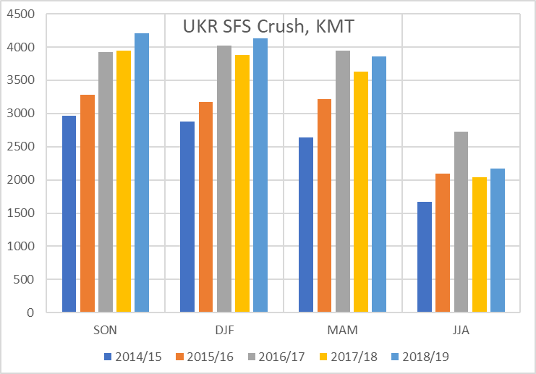
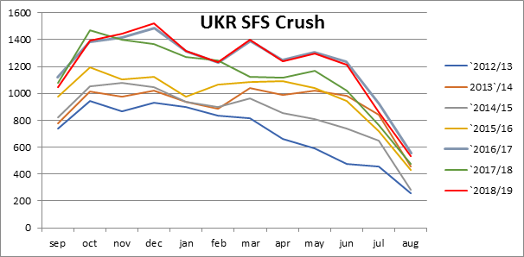
Ukrainian sunseed crush
99% crushed locally
Ample seed availability expected
Crush margin = USD 25-35
Notes:
As we said exports are about 4X more vs LY – about 200kmt, 99% of the UKR crop is crushed locally
Early on we can expect crush to run fully, taking advantage of harvest pressure and ample seed availability
Later on the crush pace declines as we head into the seasonal part where seed availability takes the lead.
this year the the seed availability first takes the lead around Jun/Jul/Aug
Toward the 2H of the season crush usually is starting to slow down.
Crush margins are positive 25-35 USD gross

Slide 7
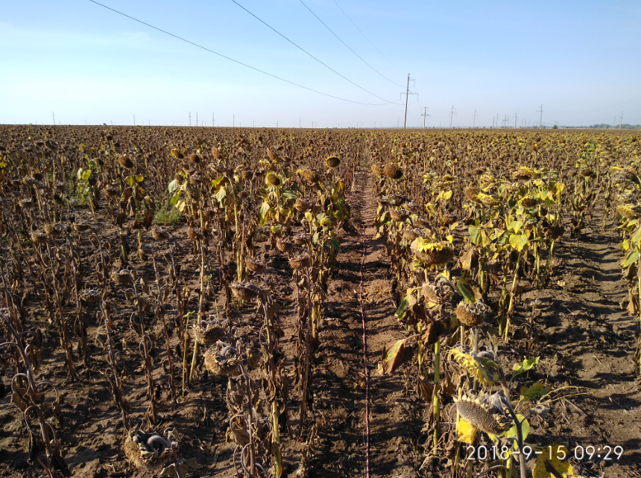
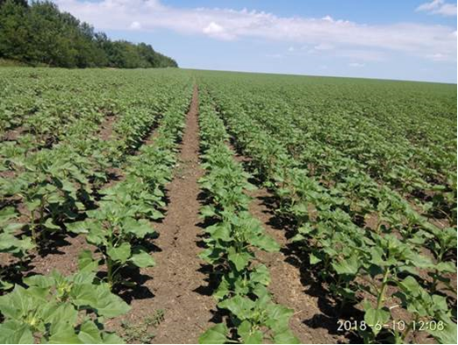
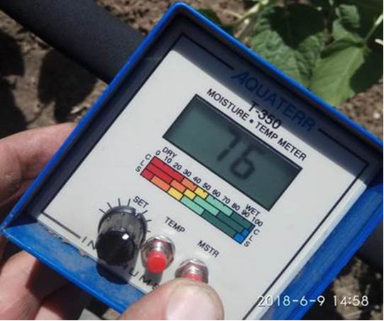
Russian sunseed market
Planting went well
Good soil conditions
Homogeneous fields and low weed pressure
Head of plant is full
Fit for storage
Increasing crop size
Notes:
Planting went well in the large picture, small increase in acreage
Waste areas of good soil moisture
Homogeneous fields during early stages and low weed pressure
The crops did not experience stress during the summer vegetation either, no cracks in the field, head of plant is full,
Fit for storage in many areas
This leads to increase in crops of 4% to 9.2mmt. Largely attributed to the increase in yields of 3%

Slide 8
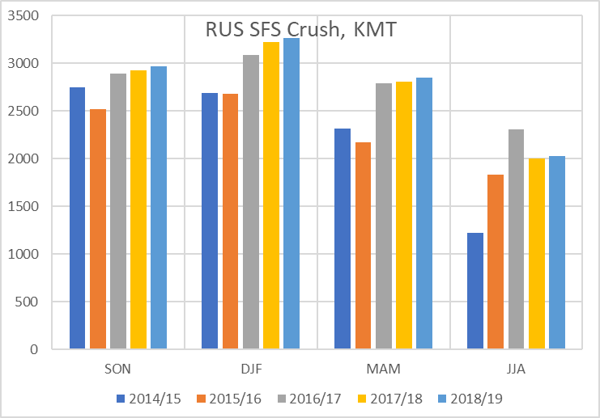
Russian sunseed crush
Crop increase absorbed by Crush
  High pace
Potential for coasters
Notes:
The larger crop is mostly absorbed into the crush – which increases by 1% (in RUS 99% is crushed as well), they actually import more than they export. Significant portion consumed outside the crush (abt 400kmt)
Same patterns as in UKR, major crushing's early in the season Jun/Jul/Aug decreases
Almost the highest crush pace in all quarters during the past 4 seasons
Exports are also estimated to double to about 200kmt, keeping C/O at a minimal level as usual

Slide 9
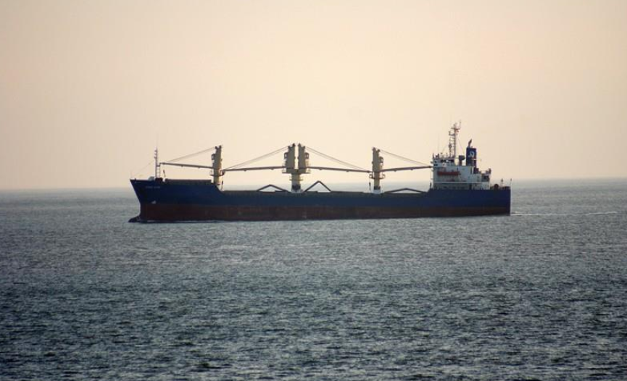
European Union sunseed market
Great conditions in Spain
Hot and dry Jul/Aug in France
  Good start and steady decline
Increasing import / decreasing exports
  Balancing Bsea SnD
  Coasters
Notes:
Yields are promising in Spain due to good rainfall early in the cycle and moderate temperatures.
Sunflower crops are struggling in FRA
After a satisfactory start - the plants suffered from the very hot, dry weather observed since early July.
The EU SFS crop will decrease by 4% due to a decrease in area
Crush will most likely be reduced by 1%
To compensate for the declining crop, imports will increase by 30% (abt 160kmt)
Exports will also decline by 34% (abt 200kmt). These 200kmt helps balance the Bsea SND, while UKR and RUS each have 200kmt more export potential, EU has almost 160kmt more need for imports and 200kmt less export potential. This compensates for all but 40kmt between these 3 majors. Should be potential for coasters both from UKR and RUS – but to early to tell for certain

Slide 10
Romanian + Bulgarian + Hungarian sunseed market
Hungary
  Excellent outlook in Jul
  Aug temperatures above norm / dry
  Low water in the rivers
Romania
  15-31 Aug hot and dry
  Jun/Jul rains and good soil moisture saved the crop
Bulgaria
  Similar Aug conditions to ROU
  Excellent yield of the combines
Limited harvest pressure initially due to rains slowing down early progress
Price depressed USD 10+ as harvest resumed
Notes:
Good yields are expected in HUN, but more promising yields were expected at the end of July vs now
Aug weather was more mixed, with temperatures sharply higher than seasonal norms and precipitation barely adequate to meet the requirements of the plants
Very difficult to move seed out along the Danube both north and south. The water level is record low (lowest in 50 years or more)
The barges load 50% of normal capacity
2H Aug was hotter and drier than 1H Aug in BUL and ROU.
Abundant rain in Jun/Jul was very beneficial for sunflower crops and bridged the deficient rains in Aug
The first sunflower cuts in south and central Bulgaria confirm the excellent potential expected this year
Currently we see limited harvest pressure, as rains stopped harvest for a couple days, just as it started picking up full speed and stopping the combines
The August lineup was high in Romania – and FS slow due to rains
Turkey was busy with the local crop showing 0 interest for Black Sea seeds spot
Export potential of ROU / BUL close to 2mmt – this will mostly stay intra EU and work its way towards southern and north western parts of EU. Overall the crop is about 2.6mmt in ROU, 1.7mmt in BUL, 1.8mmt in HUN
Moldova can end up going towards Constanta and also to a extent towards the Bsea coaster market

Slide 11
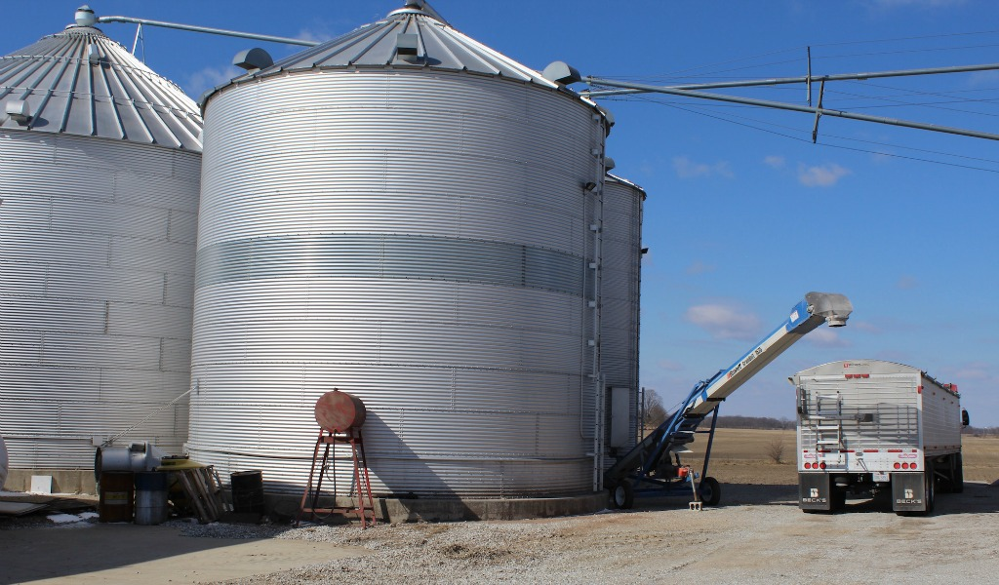
Romanian ex-farm comparison
  SFS farmer selling very slow
    Farmers unhappy with prices
    Prefer to sell Corn and Wheat
    Storing SFS
Notes:
Farmer selling is very slow in ROU due to the comparatively low prices of SFS
Prices ex-farm are unfavorable for SFS and will incentivize farmers to sell Corn + Wheat and store SFS for later in the season when they “hope” prices will improve

Slide 12
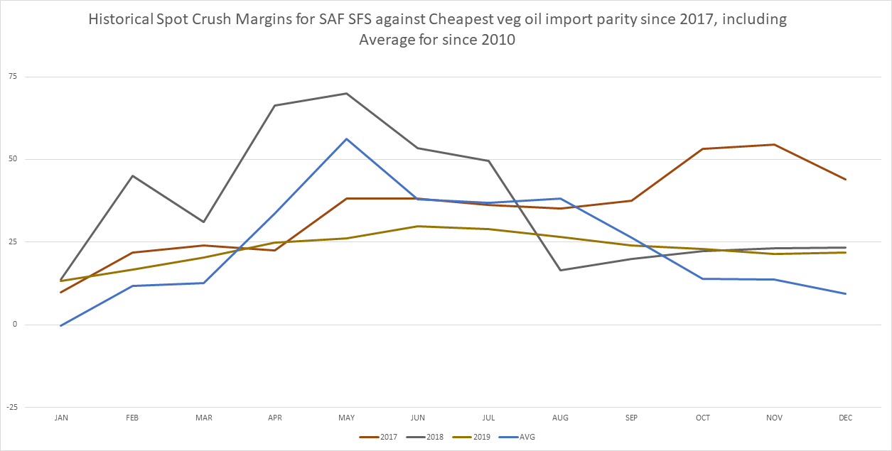
South African sunseed Market
Planting Nov-Jan
  Acreage dependent on Corn planting (high volatility)
Last SFS export 2009
  Low quality (36% oil)
Last SFS import Jan 2017
  FX uncertainty
Import possible/Seasonal price highs
Harvest/Seasonal price lows
Planting
Planting
Notes:
Planting from Nov to Jan (Sometimes even Feb) each year, with hectares being incredibly volatile and difficult to forecast. The maize farmers all prepare their fields for maize but if they do not get the opportunity to plant by latest mid Jan due to weather, they will plant SFS so they don’t waste the inputs. This means the final SFS crop size is fairly dependent on the weather during the maize crop planting progress. Later planting gives lower yields
Seasonally cheapest in AMJJ (during harvest with Majority harvested in May) - seasonally most expensive in OND with products getting cheaper internationally and big product demand pull in SAF before holiday period
Exports: SAF last exported SFS in 2009. SnD is far from that of a surplus SnD in general. Difficult to find export destinations as the SAF SFS has an incredibly poor oil content making it undesirable.
Imports: normally import OND shipment. SAF tightest at the same time as NC BSea starts to get harvested, which means if we reach import parity in the year, it would be around this time period. We would import from the EU as we get this stock duty free, and we benefit from the higher oil content. No imports since Jan 2017 due to relatively heavy SnD since.
There is a possibility this year to import, however import parity is more than what our current crush margins ($60 from import parity vs. $45 Dec CMX). Logically we should kill crush in the country before we import
Large FX related uncertainty

Slide 13
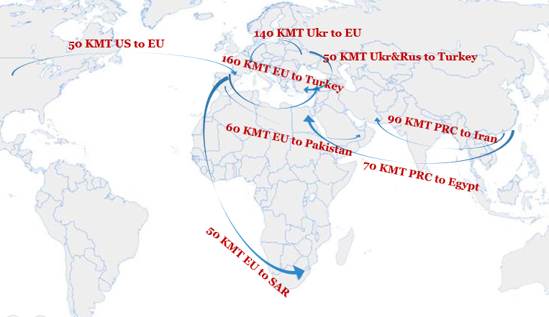
Sunseed trade flows
No ARGY export
Limited demand from PAK
  Massive SBM stocks
  Low poultry margin
Stocks available for Turkey
Notes:
Based on the past few years there will be no flow ARGY to EU
During the past 2 years it also didn’t calculate from ARGY to PAK or any other destinations for that matter – also the quality / pesticide problems still remains
The only willing buyer would be Iran if the price fits – which is rarely the case
Pakistan is importing massive amounts of Beans and struggle with large sticks of meal.
This year PAK imported 1.47mmt SBS in 17/18 vs 0.66mmt 16/17 season from the US only
The overall SBS import is up 40% year on year
The poultry margins have collapsed and culling will take place in large amounts unless the market improves
This has forced PAK to wash out Bsea RS and CAN Canola vessels. The interest for SFS is relatively limited at the moment
EU Crush margin are good and we expect 140kmt from UKR to EU
Turkey will depend on the FX rates and CMX with some uncertainty, but we assume there will be imports from EU (160kmt), RUS+UKR (50kmt) and
South Africa has potential for some imports, but very uncertain at the moment due to crop and FX. Expect Zero exports / somewhere between zero and 50kmt imports

Slide 14
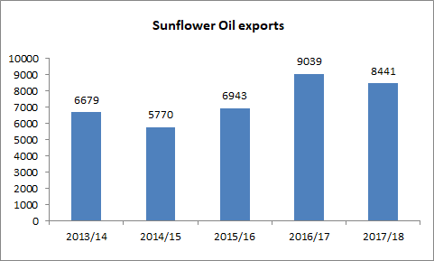
Sunflower oil
SFO exports declined more vs SFS production LY
Opposite could be expected this season
Net importers vs exporters: crop made in EU vs UKR + RUS
-7% SFO exports
-3% SFS crop
Notes:
The SFO exports declined in 17/18 vs 16/17 by 7% while the SFS crop only declined 3% the reason for this is largely found by looking at where the decrease were found
Of the major SFO net exporters (UKR, RUS, ARGY) all but ARGY experienced declining production last season (17/18). the overall SFS production declined only by 1.1mmt (3%) while SFO exports declined far more drastically.
The reason for this is larger production in EU of 1.1mmt ( 13%) which is a net importer of SFO while UKR and RUS saw 10% and 4% declines respectively. This lowers the exportable surplus and the demand for imports via EU larger crop
This year we see the opposite pattern
EU SFS crop declining by 0.4mmt or 4%
UKR increasing by 1.1mmt or 8%
Russia increasing by 0.4mmt or 4%
This will lead to a larger export and exportable surplus of SFO which again will put pressure on the oil price, and as mentioned earlier might pressure the EU CMX down

Slide 15
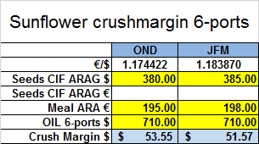
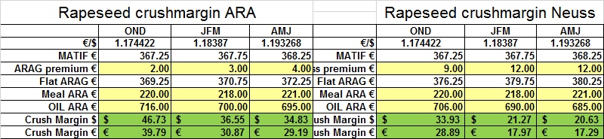
European union crush
OND margin RS vs SFS equal
Margins favoring SFS Jan – Feb
Large switch to US SBS
SFO market will see pressure
Notes:
At the moment CMX in EU is very decent, and crushers are happy to run on SFS.
At the moment the SFS CMX is relatively similar to RS for costal plants (considering costs) on OND, but for JFM SFS outperforms RS
However, without a doubt, the best CMX is if you run on US beans, the CMX at this point is above USD 70. Thanks to the trade war between US and China creating a massive price disparity between South American and US origin beans for all countries except China
Due to the bumper crops in RUS and UKR we would not expect the EU SFS CMX to remain this good
The SFO market will most likely feel the pressure from oil flowing out of RUS+UKR which will cause the EU CMX to slowly grind lower

Slide 16
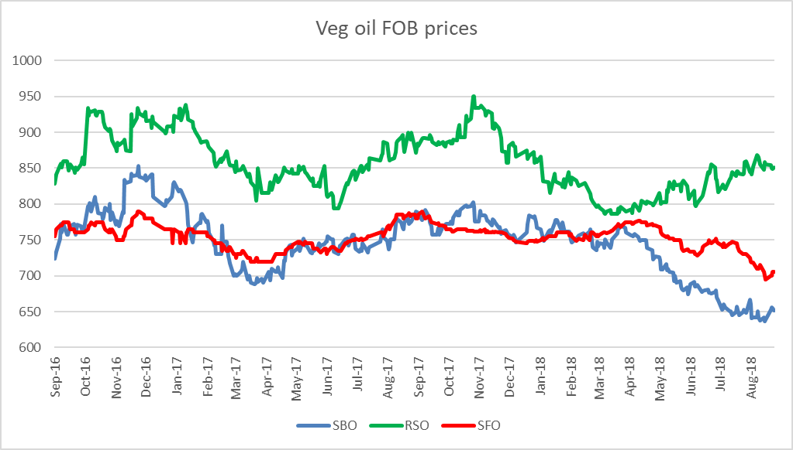
Sunflower oil vs other oils
Past 6 months:
  RSO increasing
  SBO declining
  SFO at increasing discount to RSO
SFO buying market share
Notes:
SBO - argentina
SFO - Ukraine
RSO - Europe
Relative values speak against RSO consumption, RSO has been steadily increasing for the past 6 months
SBO has steadily declined during the same timespan
SFO finds itself in the middle looking attractive vs RSO and should slowly buy marketshare
Palm cheapest

Slide 17
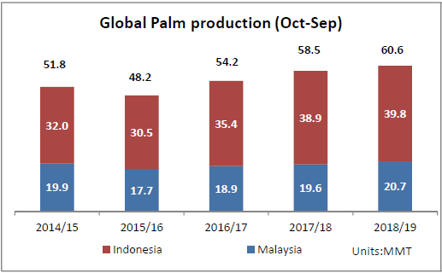

Palm oil
Heavy SND nearby
  Oct-Dec stocks large
  Jan-Jun 2019 stocks expected to decline in Indonesia/Malaysia
PME import margins to EU remain strong
Sep
OND
Notes:
Palm oil SnD is heavy as the world is much more interested in Meals vs Oils lately
Coming years production is slightly higher vs LY and INDO and MAL stocks will be very high OND
This will change going into Jan-Jun whenre stocks will significantly decline and also below LY Palm stocks
At the moment Palm is the cheapest oil in the market and PME imports into EU is very profitable. Comparatively import margins for SME is -100 USD / MT

Slide 18
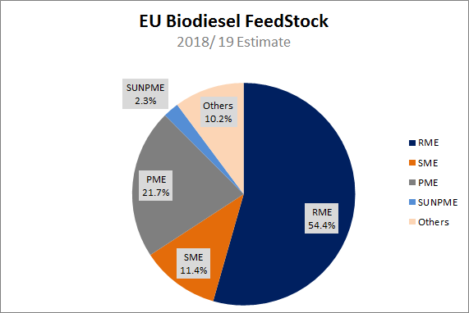
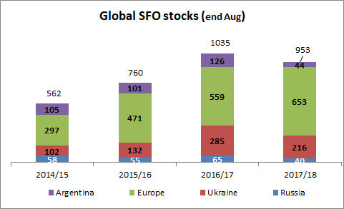
Bio-Diesel
ARGY SME will be substituted
  New export tax differential
  USD -100/mt blending margin
SFME possible in southern EU
  RSO/SFO at USD 80 = higher blending
Notes:
Stable bio-diesel use, no large
SFO based Methyl ester – low at only 2.3% of overall blend
Only possible in south such as spain+southenr France+Portugal due to high freezing point
In terms of global SFO the use in bio-diesel is very low in %, but can easily change the end stocks fully if incorporated more
SME in this case is largely ARGY origin, which will fall away due to changes in the ARGY export duty. Previously AGRY SME was cheaper than SBO due to export tax differential. As taxes incentivized local SME production vs SBO export
With the new and more similar taxes on SBO (25%) and SME (18%) + 4 peso per USD additional tax ARGY SME is USD 100+/mt away form calculating and will fall out of the blend
This will be largely substituted by RSO while RSO in food consumption will be partially compensated by US origin SBO and Palm oil
SME is rplaced by RME which comes from 1 unit RSO + 0.12 unit ethanol = 1 unit RME + 0.1 unit Methyl ester (SOLD SEPARATELY)
In Europe, RME production margins are positive for Oct and negative forward. In Fame 0 and Fame -5 blend, there is no incorporation of SME (very expensive). FAME 0 has 45% RME and FAME -5 has 85% RME.
PME import margins into Europe are +80 USD for Oct, but decline sharply in Nov/Dec due to winter months.
If RSO is 80+ USD premium to SFO – southern areas might incorporate SFO in the blend quickly increasing demand

Slide 19
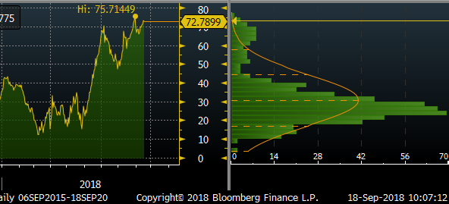
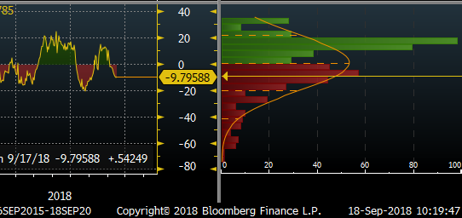
Sunflower meal potential
China minimizing US origin SBS import
  Large increase in spreads over US SBS
  Strong margin for other origins crushing US beans
SFM one of potential substitutes
  China certified 17 new UKR plants
  7 previously
CAN Canola vs US SBS
CAN Canola vs BRA SBS
Notes:
Due to trade war China will minimize SBS imports from the US wile maximizing all other origins
This has supported Canola and even EU RS as the market expects China to switch in big scale to other sources of protein
China can only import from certified plants – right after the trade war talks China certified 17 UKR crush plants
If trade war goes on it should be supportive for SFS as China could show more interest in SFM provide prices are competitive

Slide 20
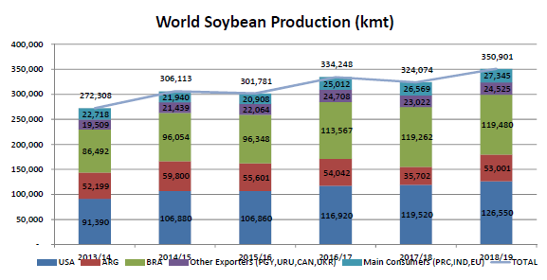
Global soybeans market
World production increasing 8%
Largely on the back of
  ARG +17mmt
  USA +7mmt
C/O remains large
Notes:
World production is bouncing back towards 351mmt and thereby increasing 8%
Mainly on the back of ARG +17mmt (+48%) and USA +7mmt (+6%)

Slide 21
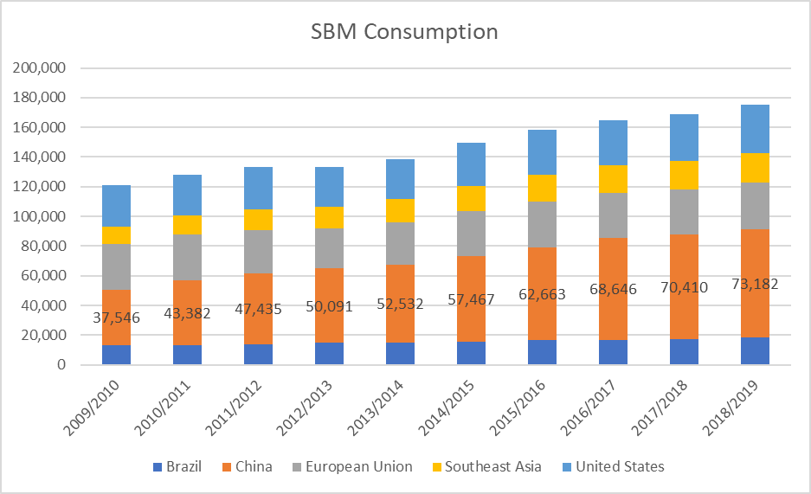
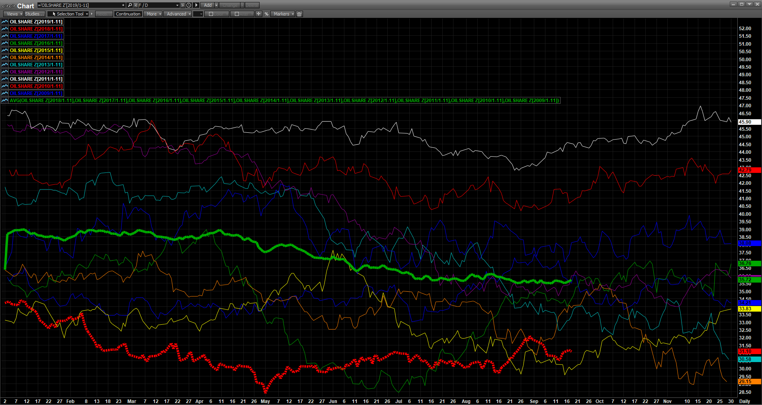
Global soybean Meal market
World demand 239mmt (+4%)
China 73mmt (+4%)
How much substitution will we see?
Oilshare historic low
  Crushing for protein
  To much oil
Notes:
Meal demand remains storing, oilshare is historically low and the world has to much oil. Seeds are processed for meal and proteins
The large question is how much SBM china will take, USDA anticipates a 4% increase but it is very unsure how much substitution we will see to other meals such as canola meal, SFM and so fourth

Slide 22
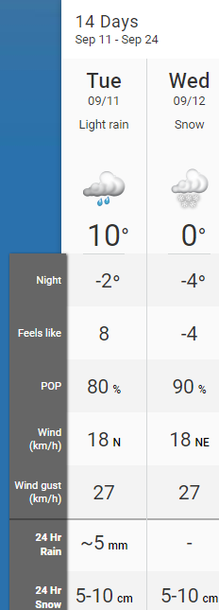
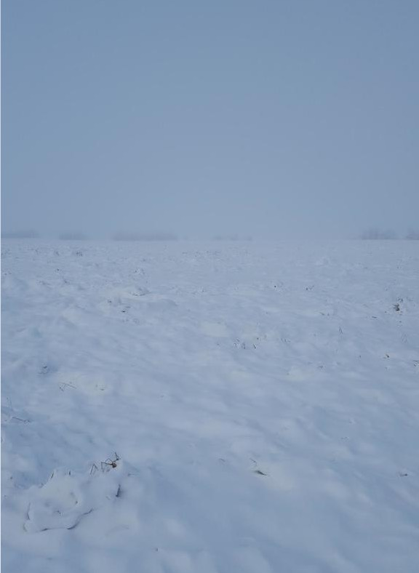
Canadian canola market
22.2mmt initially
  Delayed plantings
  Hot and dry
  Frost and snow
21.2mmt current estimate
Farmer selling focusing on wheat
Harvest still ongoing
Northern Saskatchewan
Notes:
We started with 22.2mmt crop in Canada, but have cut 1mmt over the course of the growing season
We had delayed plantings
and then hot and dry,
and now finally frost and snow
C/O and stocks to use still looks healthy. Farmers focusing on selling wheat and canola remains muted
40-50% of the crop is still standing in the fields and snow would be a major problem especially for the parts already swathed

Slide 23
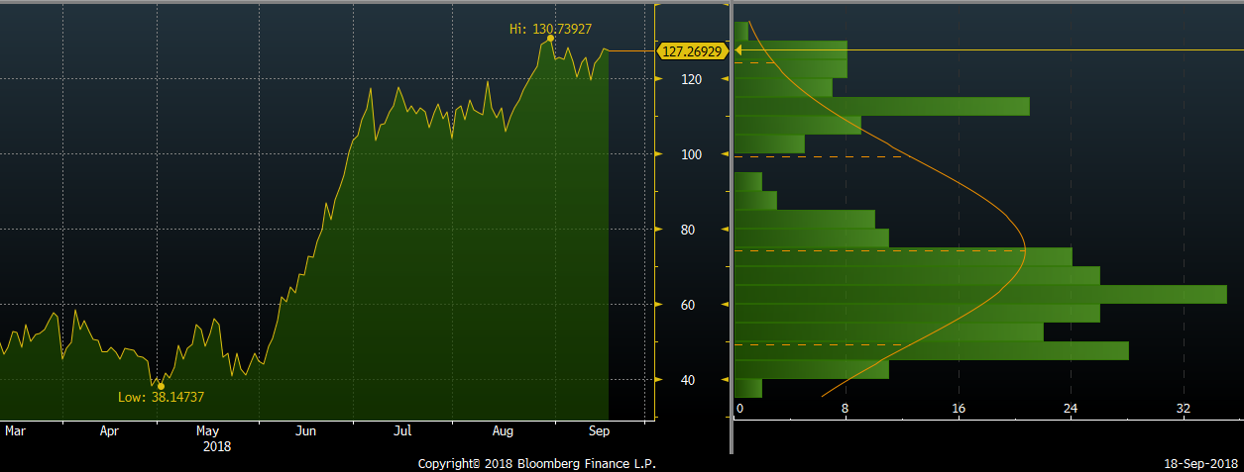
European rapeseed market
Price spread supporting SBS crush
  Keeping C/O large
Initial crop and C/O heavy
  Winter kill
  Too wet
  Too dry
Decline of 2.5mmt or -13%
Spread to SBS decreasing crush
Notes:
Initially crop was massive and C/O would have been very heavy
Then we got winter kill followed by to wet conditions especially in FRA
And after that we got the extreme dryness in FRA and GER and generally in Northern EU
This lead to the decline of 2.5mmt or -13% over just 4 months
Luckily, SBS CMX is very high and lead to crush with switch lines switching – and awe therefore still have a comfortable stocks to use in the forecast

Slide 24
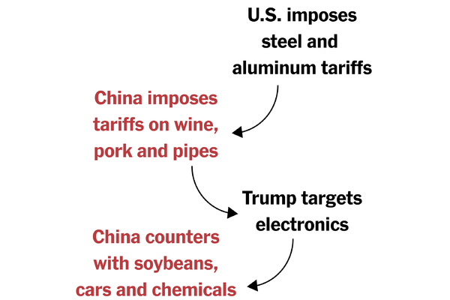
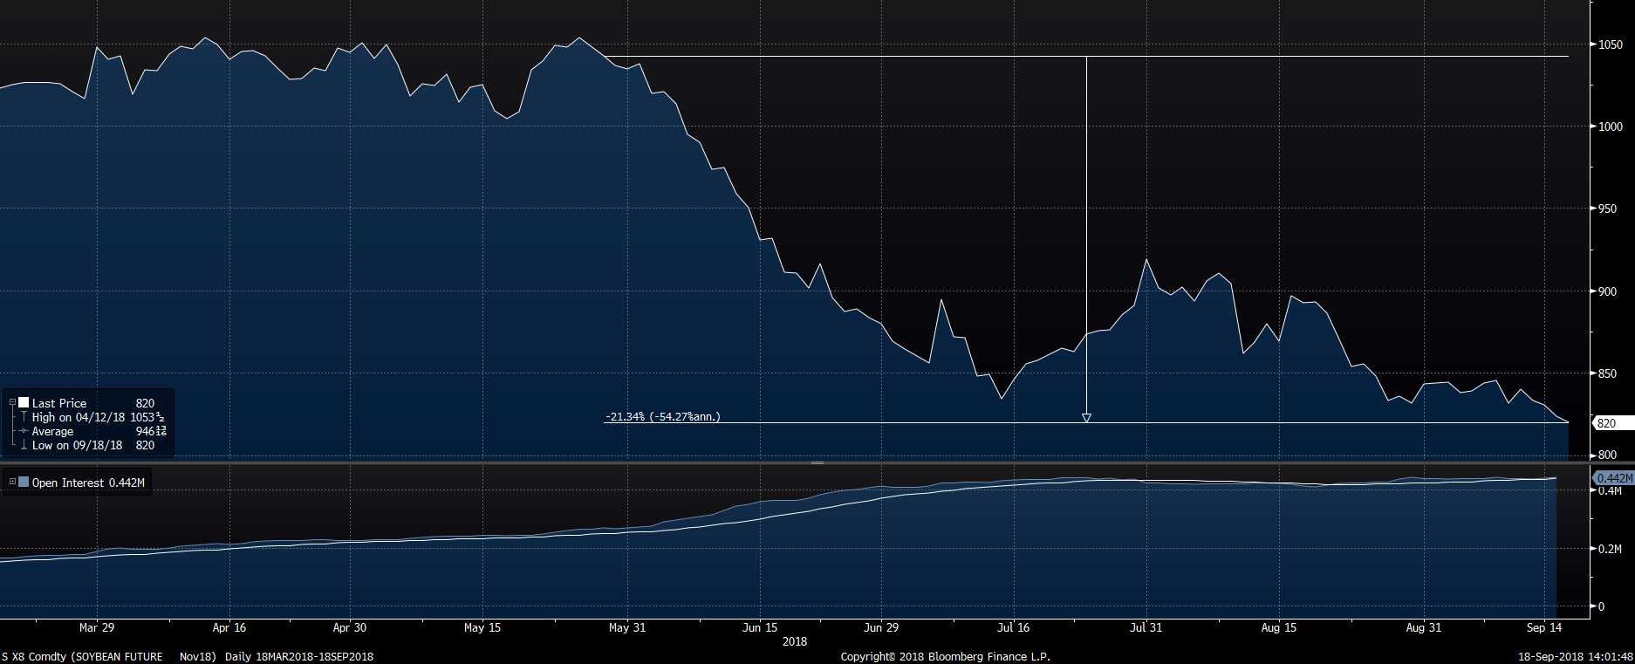
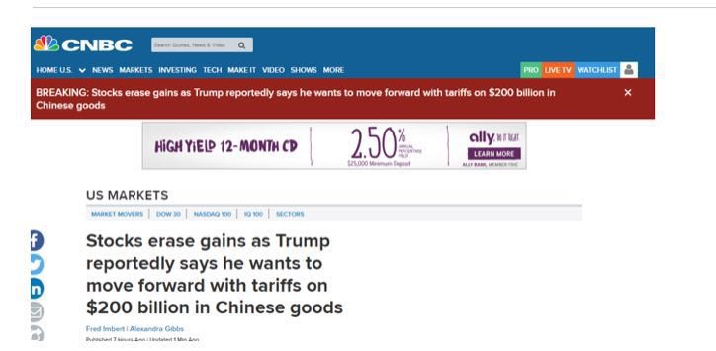
Unknown: currency & trade war
April 4th – China says retaliation will include SBS
May 29th – USA moves forward with 25% tariffs on $50 billion of imports
  CBOT SBS decreased 21%
CBOT SBS Nov 18
Notes:
At the moment we have massive turbulences in both currencies and trade flows. The most notable change is between US and China
It all started with steel and aluminum tariffs but escalated quickly
China wowed to include SBS in retaliation
USA moved forward 29th of May with the first 25% tariff on 50 billion USD worth of imports
China moved as well and SBS has declined 21% since then. However also due to favorable growing conditions and good yields
Just this week Trump announced to move forward with 10% import tariffs on additional 200 billion USD worth of imports
China will retaliate with tariffs on 60 billion USD worth of goods from September 24th
Difficult to say where this will go now, as its only up to politics to change the world trade flows

Slide 25
Thank you

